Slide 1
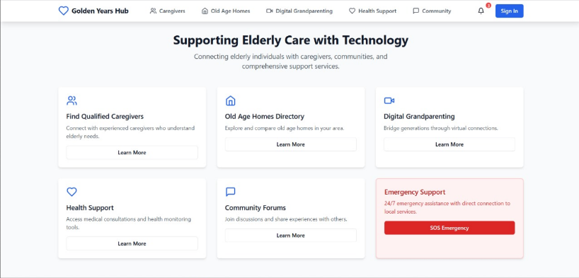
Golden Years Hub
Website dedicated to addressing the needs of elderly individuals.
Providing services such as hiring qualified caregivers, health consultations, digital grandparenting through video calls.
Presented by:
L PRANAY REDDY 22BCT0069
ATIF S 22BCT0193
VARUN TEJA MADDIRALA 22BDS0415

Slide 2
OBJECTIVE
The goal is to design and develop a comprehensive website dedicated to addressing the needs of elderly individuals. The platform will provide services such as hiring qualified caregivers, maintaining a database of old age homes, offering digital grandparenting services, facilitating health consultations via video calls, and implementing additional features to tackle challenges faced by elders in old age homes

Slide 3
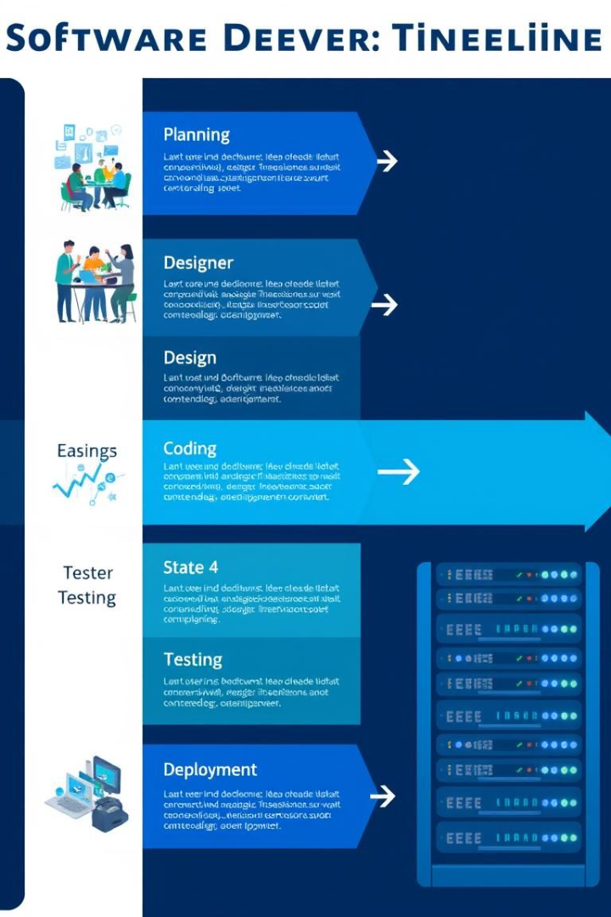
Development Plan
1
Analysis
Gather detailed requirements.
2
Design
Create UI/UX mockups.
3
Development
Build backend, frontend.
4
Testing
Functional and usability testing.

Slide 4






Key Stakeholders
Elders
Caregivers
Administrators
Health consultations, caregiver connections.
Job applications, profile management.
Platform operations, database management.
Healthcare
Virtual consultations, health support.

Slide 5

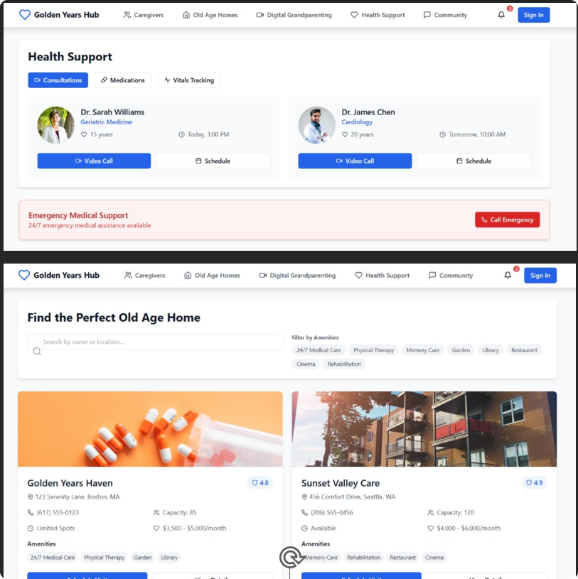




Core Features
Caregiver Hiring
List of qualified caregivers.
Old Age Home Repository
Directory of old age homes.
Digital Grandparenting
Match children with elders.
Health Support
Video consultations, health monitoring.

Slide 6
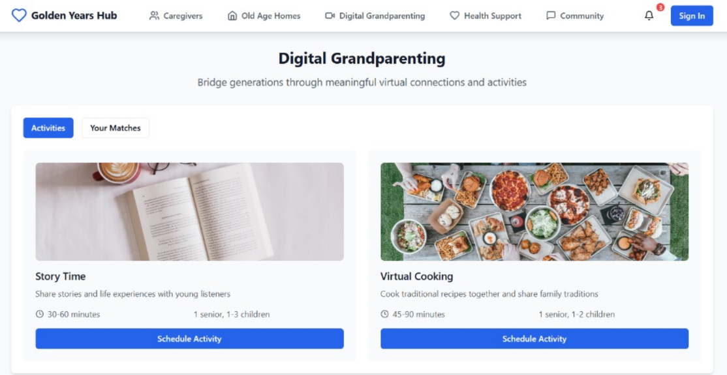
DIGITAL GRANDPARENTING
Match children without grandparents with elderly individuals willing to act as mentors or companions.
Provide virtual meeting options and activity suggestions

Slide 7
Community and Emergency Support
Community Engagement
Emergency Support
Enable forums for discussion and experience sharing.
Provide an SOS button for immediate assistance
Integrate with local emergency services for real-time alerts.
Organize online events like virtual birthday celebrations and workshops.

Slide 8

Non-Functional Requirements
Performance
Loads within 3 seconds.
Scalability
Handle 50,000 users.
Security
Encrypt user data, adhere to GDPR/HIPAA.
Reliability
99.9% uptime, backup systems.

Slide 9



UI/Design Principles
User-Friendly
Simplify navigation.
Consistent
Maintain uniform design.
Accessible
Support varying literacy.

Slide 10
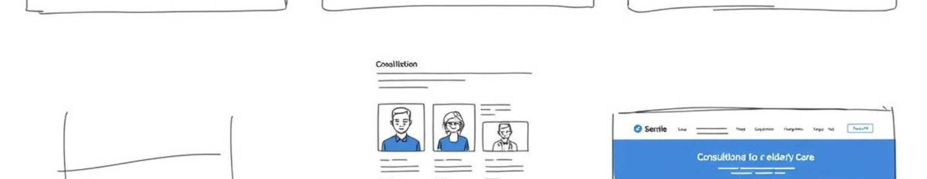




Key Components
Homepage
Caregiver Profiles
Old Age Home Directory
Consultation Portal
Overview of services.
Photos, certifications, reviews.
Interactive map.
Easy video call interface.

Slide 11
CONCLUSION
The website aims to improve the quality of life for seniors.
It will foster community connections and ensure their safety.
It will address the unique challenges faced by the elderly.
Golden Years Hub will be a reliable platform for elderly care.

